Slide 1


Computergebruik
gedistribueerd versiebeheersysteem

Slide 2
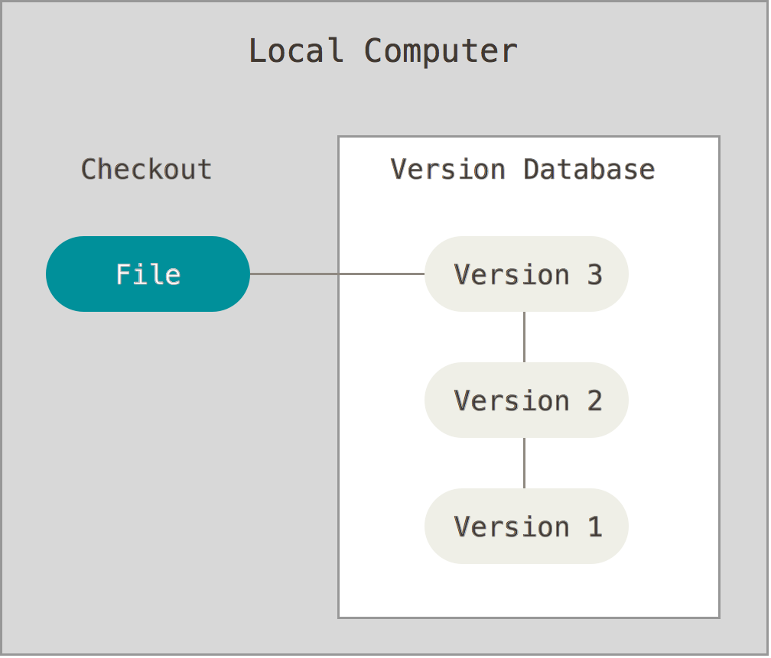
Lokale versiebeheersystemen

Slide 3

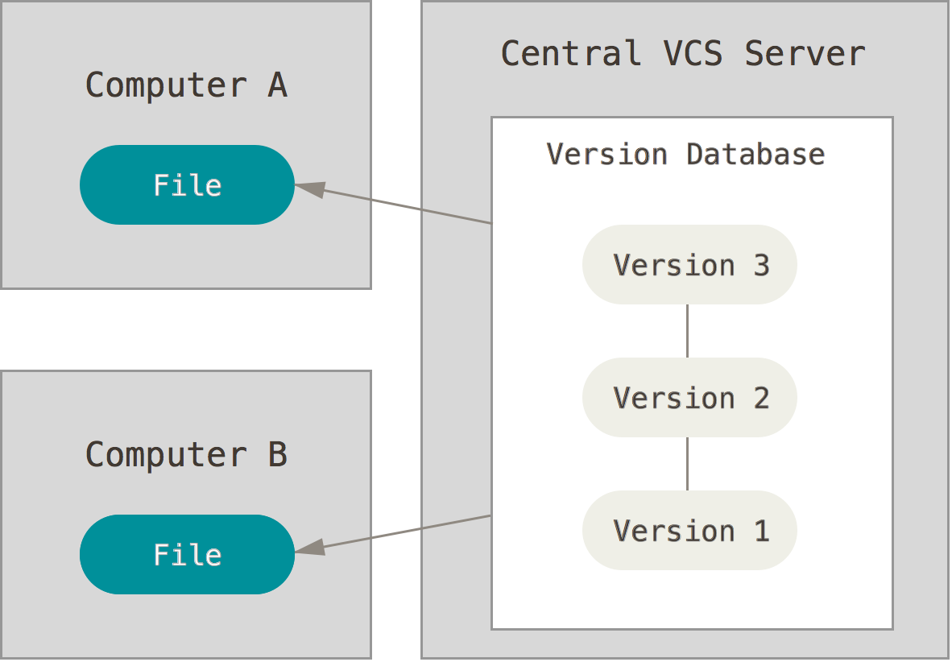


Gecentraliseerde versiebeheersystemen

Slide 4
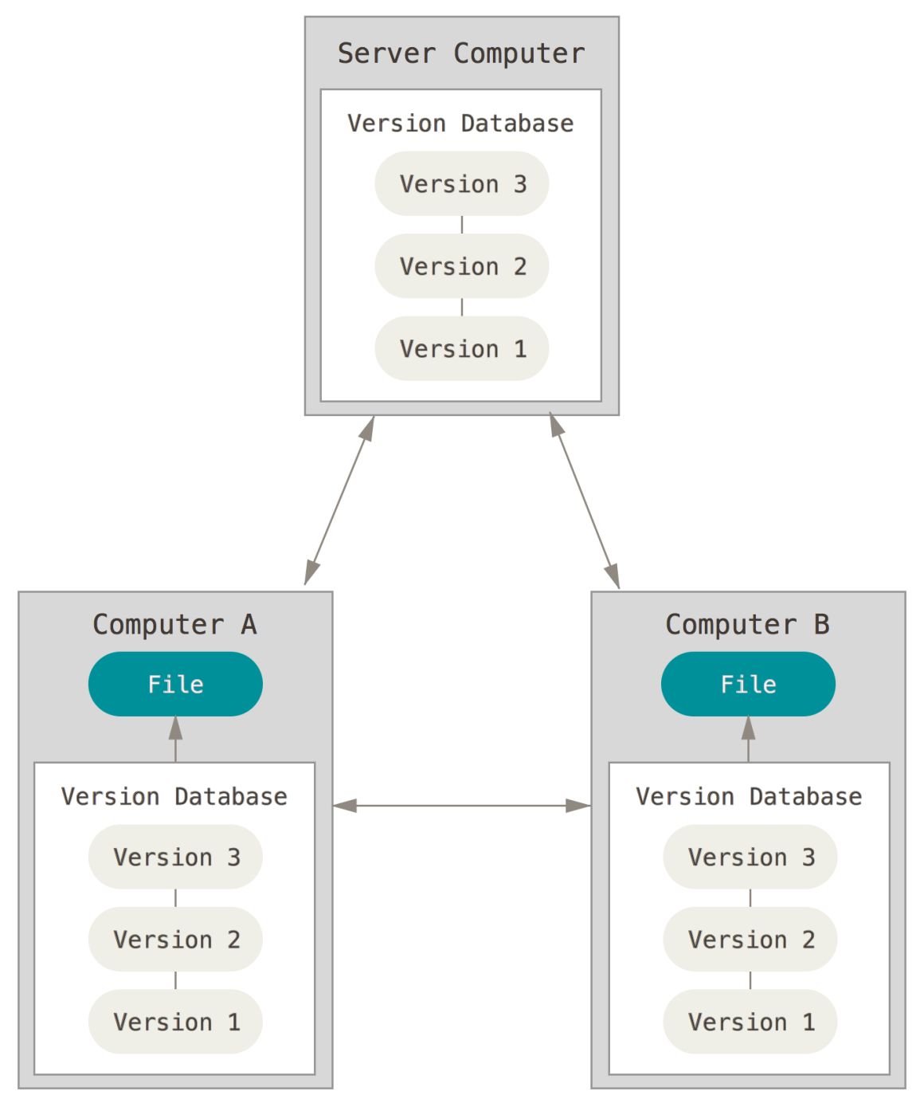




Gedistribueerde versiebeheersystemen

Slide 5
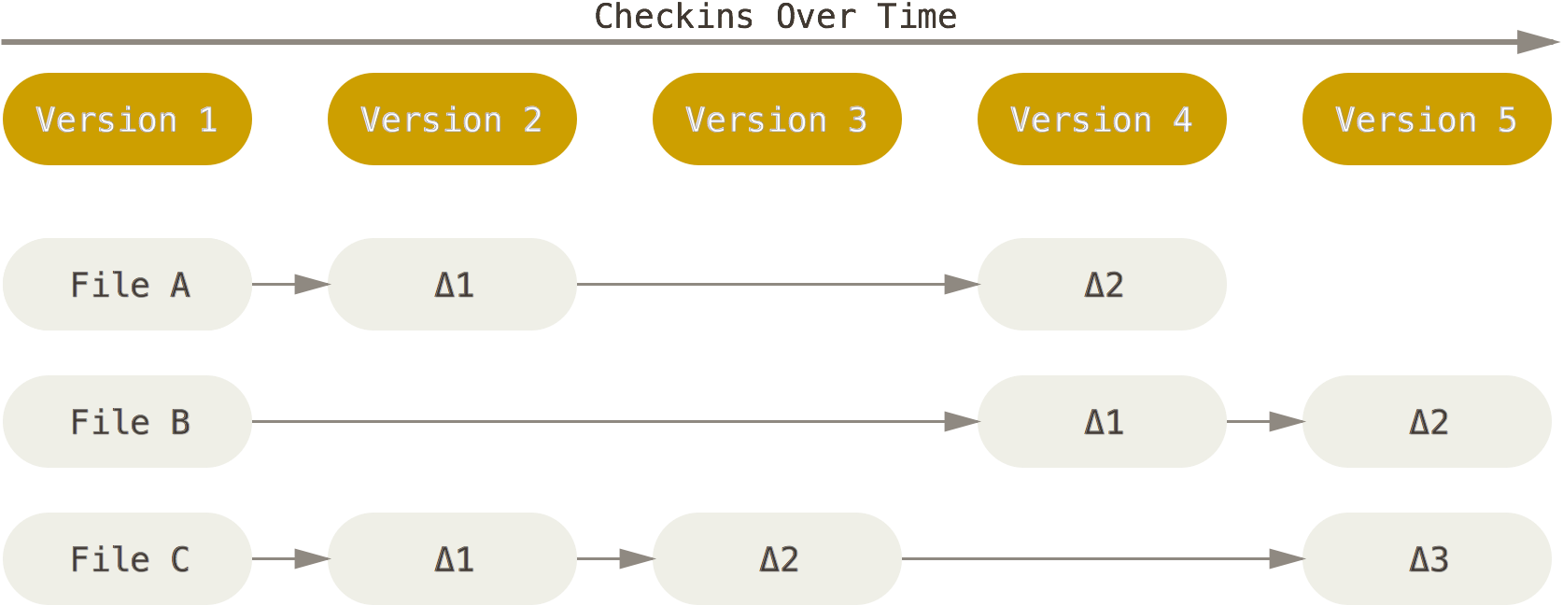
Momentopnames ↔ verschillen
data opslaan als een reeks veranderingen
aan de basisversie van elk bestand

Slide 6
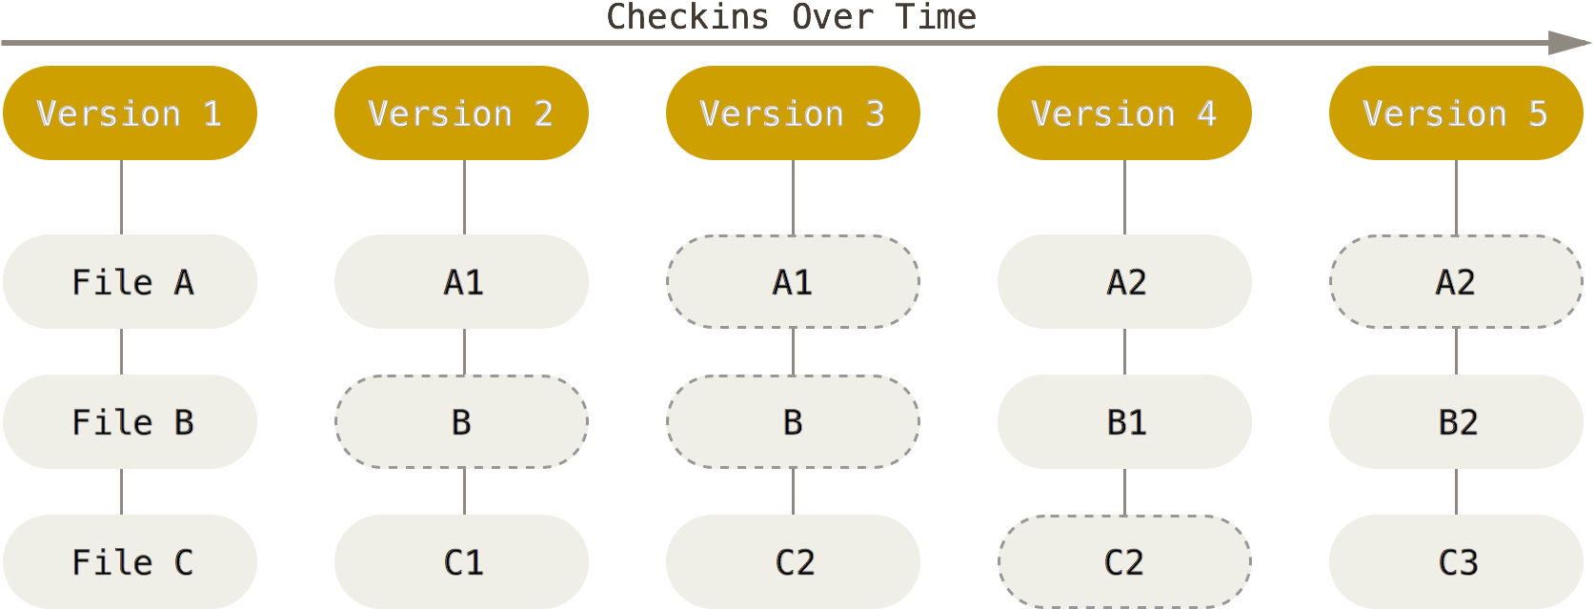
Momentopnames ↔ verschillen
data opslaan als een reeks
momentopnames van het project

Slide 7
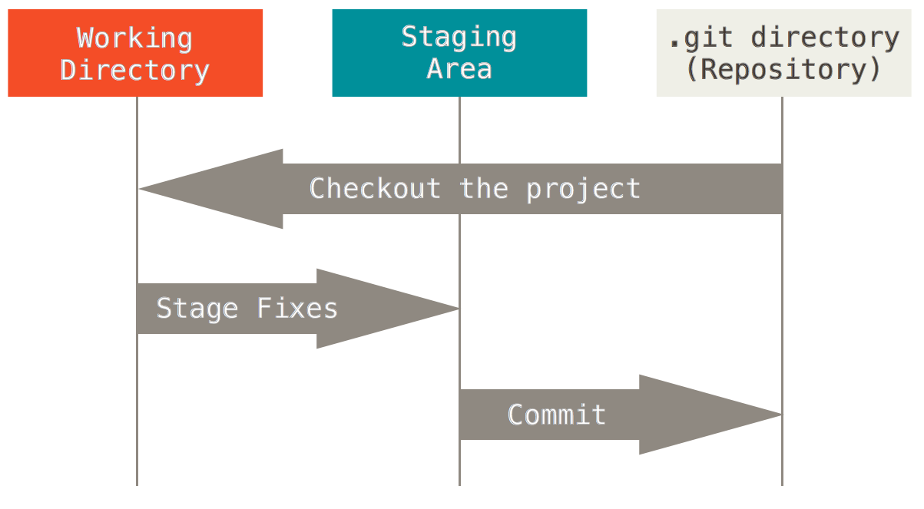
Drie toestanden van git

Slide 8

Eerste gebruik: git config
/etc/gitconfig
~/.gitconfig
.git/config
$ git config --global user.name "John Doe"

Slide 9
Eerste gebruik: git config
/etc/gitconfig
~/.gitconfig
.git/config
$ git config --global user.name "John Doe"
$ git config --global user.email johndoe@example.com
$ git config --global core.editor nano
$ git config --list
user.name=John Doe
user.email=johndoe@example.com
color.status=auto
color.branch=auto
color.interactive=auto
color.diff=auto
$ git config user.name
John Doe

Slide 10
Nieuwe repository initialiseren
$ mkdir alice
$ cd alice
$ git init
Initialized empty Git repository in ~/alice/.git/
$ ls –A
.git
$ touch README
$ git add README
$ git commit –m 'eerste versie project'
[master (root-commit) 8e596be] eerste versie project
1 file changed, 6 insertions(+)
create mode 100644 README

Slide 11
Bestaande repository clonen
git clone [url] [dir]
lokaal
ssh
http/s
git
$ git clone git://github.com/schacon/grit.git
$ git clone git://github.com/schacon/grit.git mygrit

Slide 12
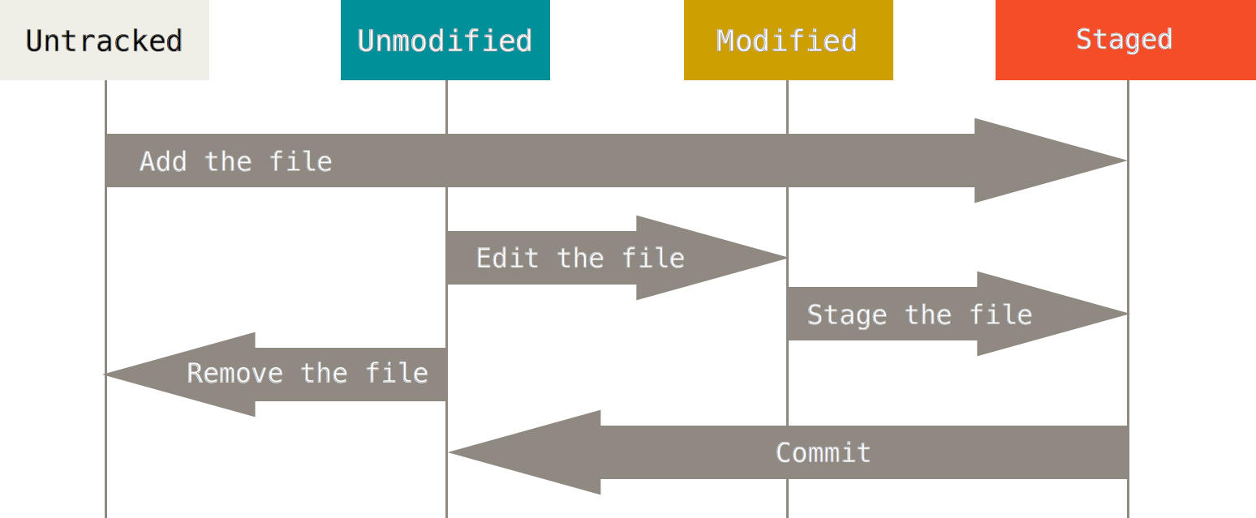
Wijzigingen vastleggen
$ git status
On branch master
nothing to commit, working directory clean

Slide 13

Wijzigingen vastleggen
$ echo -e 'auteurs\n-------\nAlice' > README
$ git status
On branch master
Untracked files:
(use "git add <file>..." to include in what will be committed)
README
nothing added to commit but untracked files present (use "git add")

Slide 14
Wijzigingen vastleggen
$ git add README
$ git status
On branch master
Changes to be committed:
(use "git reset HEAD <file>..." to unstage)
new file: README

Slide 15
Wijzigingen vastleggen
$ git commit –m 'README toegevoegd'
[master 76c9566] README toegevoegd
1 file changed, 3 insertions(+)
create mode 100644 README
$ git status
On branch master
nothing to commit, working directory clean

Slide 16
Wijzigingen vastleggen
$ nano README
$ git status
On branch master
Changes not staged for commit:
(use "git add <file>..." to update what will be committed)
(use "git checkout -- <file>..." to discard changes in working directory)
modified: README
no changes added to commit (use "git add" and/or "git commit -a")

Slide 17
Wijzigingen vastleggen
$ git add README
$ git status
On branch master
Changes to be committed:
(use "git reset HEAD <file>..." to unstage)
modified: README
$ git commit –m 'README aangepast'

Slide 18
Wijzigingen vastleggen
$ nano README
$ git add README
$ nano README

Slide 19
Wijzigingen vastleggen
$ git status
On branch master
Changes to be committed:
(use "git reset HEAD <file>..." to unstage)
modified: README
Changes not staged for commit:
(use "git add <file>..." to update what will be committed)
(use "git checkout -- <file>..." to discard changes in working directory)
modified: README

Slide 20
Wijzigingen vastleggen
$ git status -s
MM README
M Rakefile
A lib/git.rb
M lib/simplegit.rb
?? LICENSE.txt
$ git add README

Slide 21
Bestanden negeren
# do not track .a files
*.a
# but do track lib.a, even though you're ignoring .a files above
!lib.a
# only ignore the root TODO file, not subdir/TODO
/TODO
# ignore all files in the build/ directory
build/
# ignore doc/notes.txt, but not doc/server/arch.txt
doc/*.txt
# ignore all .txt files in the doc/ directory
doc/**/*.txt
$ cat .gitignore
*.[oa]
*~

Slide 22
Versies vergelijken
$ git status
On branch master
Changes to be committed:
(use "git reset HEAD <file>..." to unstage)
new file: README
Changes not staged for commit:
(use "git add <file>..." to update what will be committed)
(use "git checkout -- <file>..." to discard changes in working directory)
modified: CONTRIBUTING.md

Slide 23
Versies vergelijken
$ git diff
diff --git a/CONTRIBUTING.md b/CONTRIBUTING.md
index 8ebb991..643e24f 100644
--- a/CONTRIBUTING.md
+++ b/CONTRIBUTING.md
@@ -65,7 +65,8 @@ branch directly, things can get messy.
Please include a nice description of your changes when you submit your PR;
if we have to read the whole diff to figure out why you're contributing
in the first place, you're less likely to get feedback and have your change
-merged in.
+merged in. Also, split your changes into comprehensive chunks if you patch is
+longer than a dozen lines.
If you are starting to work on a particular area, feel free to submit a PR
that highlights your work in progress (and note in the PR title that it's

Slide 24
Versies vergelijken
$ git status
On branch master
Changes to be committed:
(use "git reset HEAD <file>..." to unstage)
new file: README
Changes not staged for commit:
(use "git add <file>..." to update what will be committed)
(use "git checkout -- <file>..." to discard changes in working directory)
modified: CONTRIBUTING.md

Slide 25
Versies vergelijken
$ git diff --staged
diff --git a/README b/README
new file mode 100644
index 0000000..ad48c40
--- /dev/null
+++ b/README
@@ -0,0 +1,3 @@
+Auteurs
+-------
+Alice

Slide 26
Versies vergelijken
$ git add CONTRIBUTING.md
$ echo 'test line' >> CONTRIBUTING.md
$ git status
On branch master
Changes to be committed:
(use "git reset HEAD <file>..." to unstage)
modified: CONTRIBUTING.md
Changes not staged for commit:
(use "git add <file>..." to update what will be committed)
(use "git checkout -- <file>..." to discard changes in working directory)
modified: CONTRIBUTING.md

Slide 27
Versies vergelijken
$ git diff
diff --git a/CONTRIBUTING.md b/CONTRIBUTING.md
index 643e24f..87f08c8 100644
--- a/CONTRIBUTING.md
+++ b/CONTRIBUTING.md
@@ -119,3 +119,4 @@ at the
## Starter Projects
See our [projects list](https://github.com/libgit2/PROJECTS.md).
+# test line

Slide 28
Versies vergelijken
$ git diff --cached
diff --git a/CONTRIBUTING.md b/CONTRIBUTING.md
index 8ebb991..643e24f 100644
--- a/CONTRIBUTING.md
+++ b/CONTRIBUTING.md
@@ -65,7 +65,8 @@ branch directly, things can get messy.
Please include a nice description of your changes when you submit your PR;
if we have to read the whole diff to figure out why you're contributing
in the first place, you're less likely to get feedback and have your change
-merged in.
+merged in. Also, split your changes into comprehensive chunks if you patch is
+longer than a dozen lines.
If you are starting to work on a particular area, feel free to submit a PR
that highlights your work in progress (and note in the PR title that it's

Slide 29
Wijzigingen committen
story 18: fix benchmark for speed
# Please enter the commit message for your changes. Lines starting
# with '#' will be ignored, and an empty message aborts the commit.
# On branch master
# Changes to be committed:
# new file: README
# modified: CONTRIBUTING.md
#
~
~
~
".git/COMMIT_EDITMSG" 9L, 283C
$ git commit
[master 463dc4f] story 18: fix benchmarks for speed
2 files changed, 2 insertions(+)
create mode 100644 README
$ git config --global core.editor nano
$ nano README
$ git add README
$ git commit -m "story 19: fix benchmarks for speed"
[master 463dc4f] Story 19: fix benchmarks for speed
2 files changed, 2 insertions(+)
create mode 100644 README

Slide 30
Staging area overslaan
$ git status
On branch master
Changes not staged for commit:
(use "git add <file>..." to update what will be committed)
(use "git checkout -- <file>..." to discard changes in working directory)
modified: CONTRIBUTING.md
no changes added to commit (use "git add" and/or "git commit -a")
$ git commit -a -m 'added new benchmarks'
[master 83e38c7] added new benchmarks
1 file changed, 5 insertions(+), 0 deletions(-)

Slide 31

Bestanden verwijderen
$ rm PROJECTS.md
$ git status
On branch master
Your branch is up-to-date with 'origin/master'.
Changes not staged for commit:
(use "git add/rm <file>..." to update what will be committed)
(use "git checkout -- <file>..." to discard changes in working directory)
deleted: PROJECTS.md
no changes added to commit (use "git add" and/or "git commit -a")

Slide 32
Bestanden verwijderen
$ git rm PROJECTS.md
rm 'PROJECTS.md'
$ git status
On branch master
Changes to be committed:
(use "git reset HEAD <file>..." to unstage)
deleted: PROJECTS.md
$ git commit -m 'project file deleted'
[master d3ae578] project file deleted
1 file changed, 0 insertions(+), 0 deletions(-)
delete mode 100644 PROJECTS.md

Slide 33
Bestanden verwijderen
$ git rm --cached README
rm 'README'
$ git rm log/\*.log
$ git rm '*~'
$ nano .gitignore

Slide 34
Bestanden verplaatsen
$ mv README.md README
$ git rm README.md
$ git add README
$ git mv README.md README
$ git status
On branch master
Changes to be committed:
(use "git reset HEAD <file>..." to unstage)
renamed: README.md -> README

Slide 35
Laatste commit veranderen
$ git commit -m 'eerste commit'
[master (root-commit) 5b3865e] eerste commit
1 file changed, 0 insertions(+), 0 deletions(-)
create mode 100644 README
$ git add PROJECT.md
$ git commit --amend
[master 2725191] eerste commit
2 files changed, 0 insertions(+), 0 deletions(-)
create mode 100644 PROJECT.md
create mode 100644 README
$ git log --oneline
2725191 eerste commit

Slide 36
Staged bestand unstagen
$ git add .
$ git status
On branch master
Changes to be committed:
(use "git reset HEAD <file>..." to unstage)
renamed: README.md -> README
modified: CONTRIBUTING.md

Slide 37
Staged bestand unstagen
$ git reset HEAD CONTRIBUTING.md
Unstaged changes after reset:
M CONTRIBUTING.md
$ git status
On branch master
Changes to be committed:
(use "git reset HEAD <file>..." to unstage)
renamed: README.md -> README
Changes not staged for commit:
(use "git add <file>..." to update what will be committed)
(use "git checkout -- <file>..." to discard changes in working directory)
modified: CONTRIBUTING.md

Slide 38
Laatste versie terughalen
$ git status
On branch master
Changes not staged for commit:
(use "git add <file>..." to update what will be committed)
(use "git checkout -- <file>..." to discard changes in working directory)
modified: CONTRIBUTING.md
$ git checkout -- CONTRIBUTING.md
$ git status
On branch master
Changes to be committed:
(use "git reset HEAD <file>..." to unstage)
renamed: README.md -> README

Slide 39
Werken met remotes

Slide 40
Remotes bekijken
$ git clone https://github.com/schacon/ticgit
Cloning into 'ticgit'...
remote: Reusing existing pack: 1857, done.
remote: Total 1857 (delta 0), reused 0 (delta 0)
Receiving objects: 100% (1857/1857), 374.35 KiB | 268.00 KiB/s, done.
Resolving deltas: 100% (772/772), done.
Checking connectivity... done.
$ cd ticgit
$ git remote
origin
$ git remote -v
origin https://github.com/schacon/ticgit (fetch)
origin https://github.com/schacon/ticgit (push)

Slide 41
Remotes bekijken
$ cd grit
$ git remote -v
bakkdoor https://github.com/bakkdoor/grit (fetch)
bakkdoor https://github.com/bakkdoor/grit (push)
cho45 https://github.com/cho45/grit (fetch)
cho45 https://github.com/cho45/grit (push)
defunkt https://github.com/defunkt/grit (fetch)
defunkt https://github.com/defunkt/grit (push)
koke git://github.com/koke/grit.git (fetch)
koke git://github.com/koke/grit.git (push)
origin git@github.com:mojombo/grit.git (fetch)
origin git@github.com:mojombo/grit.git (push)

Slide 42
Remotes toevoegen
alice
remote.git
bob
origin (fetch)
origin (pull)
~$ git clone --bare --shared alice remote.git
Cloning into bare repository 'remote.git'...
done.
~$ cd alice
alice$ git remote add origin ../remote.git
alice$ git remote -v
origin ../remote.git (fetch)
origin ../remote.git (push)

Slide 43
Remotes toevoegen
alice
remote.git
bob
origin (fetch)
origin (fetch)
origin (pull)
origin (pull)
~$ mkdir bob
~$ cd bob
bob$ git init
Initialized empty Git repository in ~/bob/.git/
bob$ git remote add origin ../remote.git/
bob$ git remote -v
origin ../remote.git/ (fetch)
origin ../remote.git/ (push)

Slide 44
Pushen naar remotes
alice
remote.git
bob
origin (fetch)
origin (fetch)
origin (pull)
origin (pull)
alice$ git push origin master
Total 0 (delta 0), reused 0 (delta 0)
To ../remote.git
3936948..4cdda8c master -> master

Slide 45
Fetchen van remotes
alice
remote.git
bob
origin (fetch)
origin (fetch)
origin (pull)
origin (pull)
alice$ git push origin master
Total 0 (delta 0), reused 0 (delta 0)
To ../remote.git
3936948..4cdda8c master -> master
bob$ git fetch origin
remote: Counting objects: 3, done.
remote: Total 3 (delta 0), reused 0 (delta 0)
Unpacking objects: 100% (3/3), done.
From ../remote
* [new branch] master -> origin/master
$ git branch -vv
* master 3936948 [origin/master: behind 1] eerste commit

Slide 46
Remotes inspecteren
alice
remote.git
bob
origin (fetch)
origin (fetch)
origin (pull)
origin (pull)
bob$ git remote show origin
* remote origin
Fetch URL: ../remote.git/
Push URL: ../remote.git/
HEAD branch: master
Remote branch:
master tracked
Local branch configured for 'git pull':
master merges with remote master
Local ref configured for 'git push':
master pushes to master (local out of date)

Slide 47
Pullen van remotes
alice
remote.git
bob
origin (fetch)
origin (fetch)
origin (pull)
origin (pull)
bob$ git pull
Updating 3936948..4cdda8c
Fast-forward
README | 3 +++
1 file changed, 3 insertions(+)
bob$ cat README
auteurs
-------
Alice

Slide 48
Remotes verwijderen en hernoemen
alice
remote.git
bob
origin (fetch)
origin (fetch)
bron (fetch)
origin (pull)
origin (pull)
bron (pull)
bob$ git remote rename origin bron
bob$ git remote -vv
bron ../remote.git/ (fetch)
bron ../remote.git/ (push)
bob$ git remote rm bron
bob$ git remote -vv

Slide 49

TryGit

Slide 50

Vragen of opmerkingen ?

Slide 51
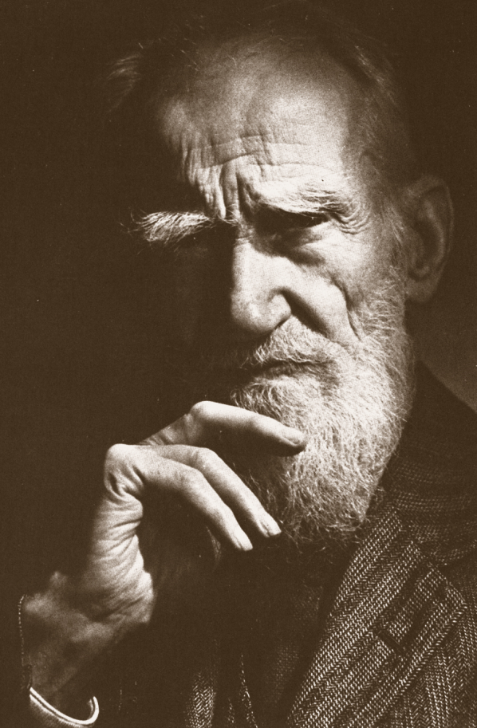
The sky is the limit…
George Bernard Shaw
1856-1950
"If you have an apple and I have an
apple and we exchange apples then
you and I will still each have one apple.
But if you have an idea and I have an
idea and we exchange these ideas,
then each of us will have two ideas."
⎯ George Bernard Shaw

